Slide 1
Personality Preferences

Slide 2
Define Personality
In Class Activity: Write your own definition of what personality is using your non-dominant hand.

Slide 3
Personality is…
Personality does not change, though our behaviors are flexible depending on the situation
Think about the differences that exist within you and your siblings.

Slide 4
What’s the Point?
Assist you in making career decisions
Creating teams in work settings
Assigning tasks and organizing responsibilities within a group
Insights into personal relationships ad interactions
Learning about those who seem opposite
It’s impact on your style of decision making

Slide 5
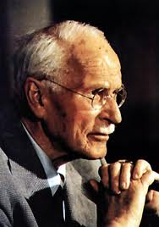
Carl Jung
1921, theory of psychological types
Explained the differences between healthy people
People have natural preferences to use their minds in certain ways
This results in patterns of behavior

Slide 6
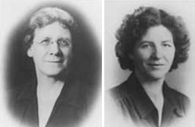
Myers-Briggs
Isabel Myers and Katharine Briggs
Mother-Daughter Team
Further researched Jung’s ideas on personality
Widely used in education, work, and counseling settings.

Slide 7
MBTI
Where you focus your energy and attention?
How you take in information?
How you make decisions?
How you deal with the outer world?

Slide 8
Myers Briggs Type Indicator
Looks at our orientations and attitudes towards people, careers, and life.
4 Pairs
Introversion vs. Extroversion
Sensing vs. Intuition
Thinking vs. Feeling
Judgment vs. Perception
Helps us to understand WHY occupations are of interest to us.

Slide 9
The Four Dichotomies
Extroversion OR Introversion
Sensing OR iNtuition
Thinking OR Feeling
Judging OR Perceiving

Slide 10
Focus of Energy and Attention
Extroversion vs. Introversion
E_______________________________________I
Clarification of Terms
Use the table provided
Identify your preferred work environment
extroversion vs. introversion

Slide 11
Taking In Information
Sensing vs. Intuition
S_______________________________________N
Use the table provided
Identify your preferred work environment

Slide 12
Making Decisions
Thinking vs. Feeling
T______________________________________F
Clarification of Terminology
Use the table provided to identify your preference
Which work environment best fits you?

Slide 13
Dealing with the Outer World
Judging vs. Perceiving
J_________________________________________P
Clarification of terms
Use the table provided
Which work environment best fits you?

Slide 14
Estimate your own Personality Type
Make an estimation of your type in the boxes
Then read through the description of all 16 types on pages 72-73

Slide 15
MBTI and Careers
Take the MBTI
Score the MBTI
Read about your type and careers/majors

Slide 16
“Out of Type”
Using preferred behaviors and tendencies requires less effort
There is room for every type in every occupation and career environment
Why is being aware of your potential weaknesses considered vital?

