Slide 1
Chapter 2
Values

Slide 2
Let’s talk values
Influenced by family, friends, religious, and cultural backgrounds
Subjective
Specific values can have a variety of definitions. For ex. “success”
We tend to be satisfied when our work corresponds to our values.

Slide 3
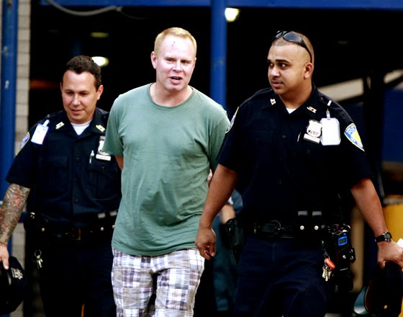
Worst Job Ever?
What do you do
What are the working conditions?
What are the pay and benefits?
Whom do you work with?
Whom do you serve?
What services do you provide or products do you make?
What type of supervisors do you have?
What are the requirements and demands of the job?

Slide 4
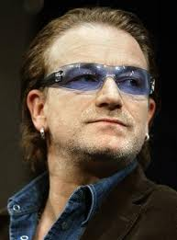
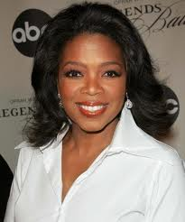
Dream Job
Write a paragraph in your notes about your dream job. Use your imagination to create as many details as possible. What would the perfect job look like for you?
Now, reread your work and pick out the values that you see. What did you learn about yourself?

